Slide 1
CNN based U-Net with Modified Skip Connections for Colon
Polyp Segmentation
Sushma B Raghavendra C K Prashanth J

Slide 2
Abstract
Colonoscopy is a medical procedure performed to detect the anomalies in the colon and rectum, The physicians find it very challenging to diagnose small polyps in colonoscopy video
In this work UNET architecture with spatial attention layer is proposed to improve the precision of segmenting polyp regions in colonoscopy video. The CNN models proposed in the literature for polyp segmentation are basically trained using common loss functions such as dice and binary cross entropy loss

Slide 3
Abstract
UNet, a popular encoder-decoder based CNN architecture with skip connections is the accepted choice for image segmentation [6]. Due to continuous down- sampling of features at different levels on the encoder, side informations associated with edges and small objects is lost during up-sampling in the base-line UNet architecture.
In this work UNET architecture with spatial attention layer is proposed to improve the precision of segmenting polyp regions in colonoscopy video. The CNN models proposed in the literature for polyp segmentation are basically trained using common loss functions such as dice and binary cross entropy loss

Slide 4
Abstract
To overcome the above problem, techniques such as pyramid pooling and attention mechanism are introduced in encoder decoder based architectures.

Slide 5
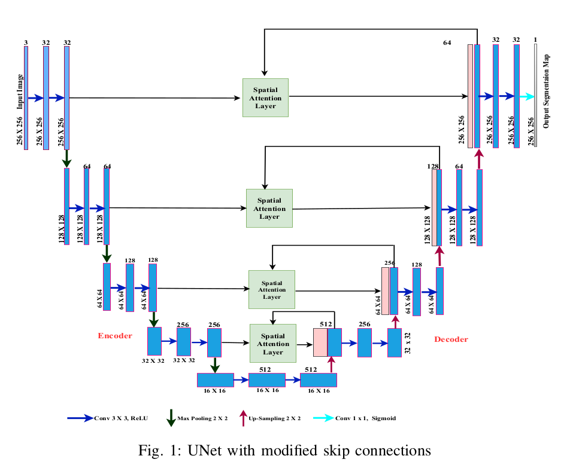
Network Architecture
The modified UNet model with spatial attention layer is end-end trainable.
The encoder network consists of a series of con layers with batch normalization and Relu activation followed by Max pooling layers.
The decoder network consists of series of transposed conv layers that up-samples features back to the original image size followed by modified skip connections that concatenate the features from the corresponding encoder layer through SAL (Spatial attention layer)
SAL is used to generate the spatial relationship between the features produced at each stage of the encoder, in order to extract spatial information from low-level features

Slide 6
Loss Functions
In Image Segmentation , the choice of loss functions is crucial in training deep learning models
In the proposed work , UNet and UNet with modified skip connections is trained with various loss functions which are binary cross entropy (BCE) , Dice Loss and Mean Squared Error - however these loss functions didn’t effectively segment small polyps as they weigh false positives and false negatives equally resulting in high precision and low recall .
So they propose using Focal Tversky Loss(FTL) to balance the detection of false negatives and false positives..

Slide 7
Dataset Details
To train the model a popular polyp segmentation dataset KVASIR-SEG [15] is used. Dataset consists of around 2134 images with polyps and corresponding segmentation masks.
Results
In the results section of the paper, the authors compare the performance of their UNet model with modified skip connections (UNet-MSC) to a standard UNet model with plain skip connections. Both models were evaluated using different loss functions and compared using precision, recall, and standard deviation metrics. The authors found that the UNet-MSC model trained with Focal Tversky loss (FTL) achieved the best results, with low standard deviation in precision and recall

